Slide 1

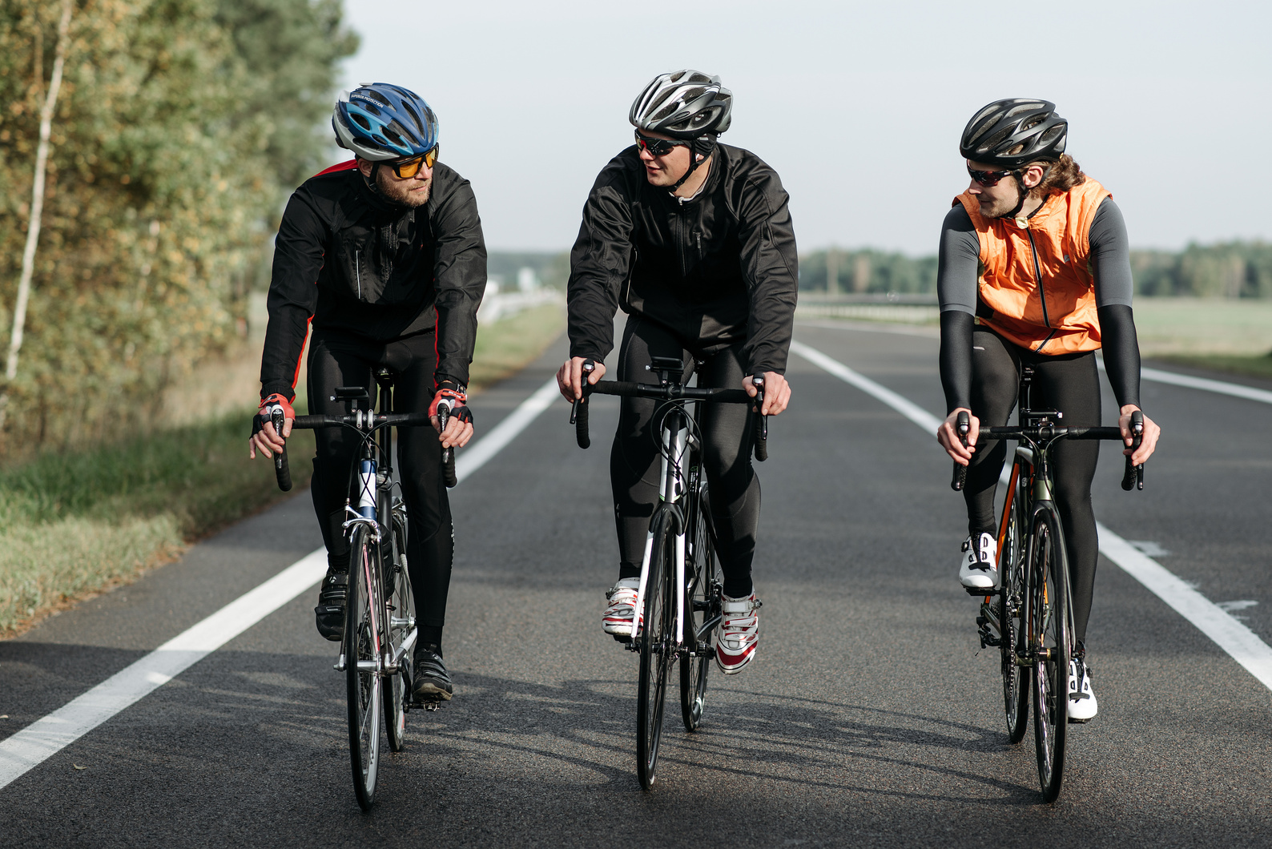
Cyclistic
Case study:
How does a bike-share navigate speedy success?
Presented by Nij Hingrajiiya

Slide 2
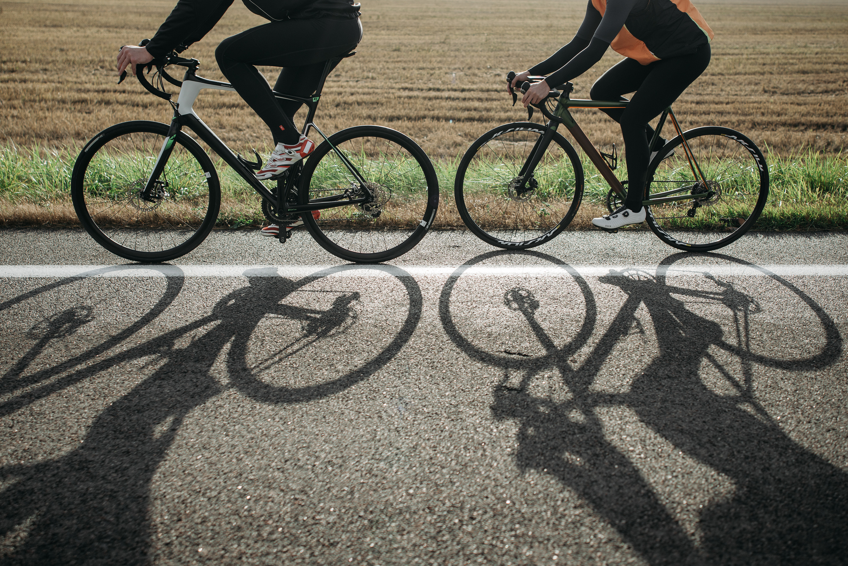
Business Task
Objective
Goal
Understand how members vs. casual riders use bikes differently
Recommend strategies to convert casual riders into annual members

Slide 3

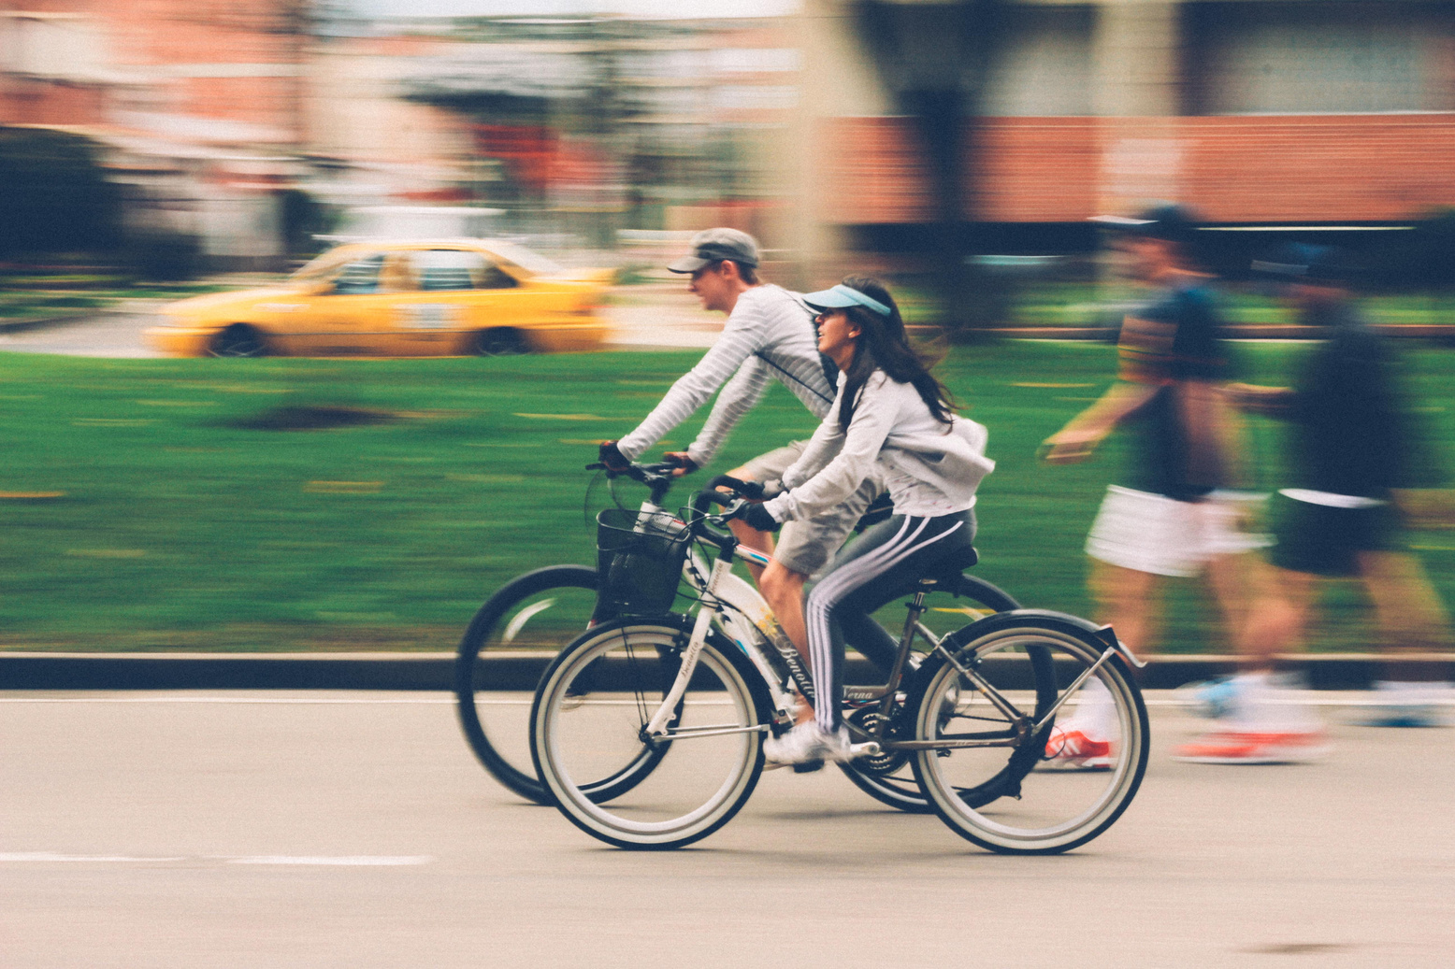
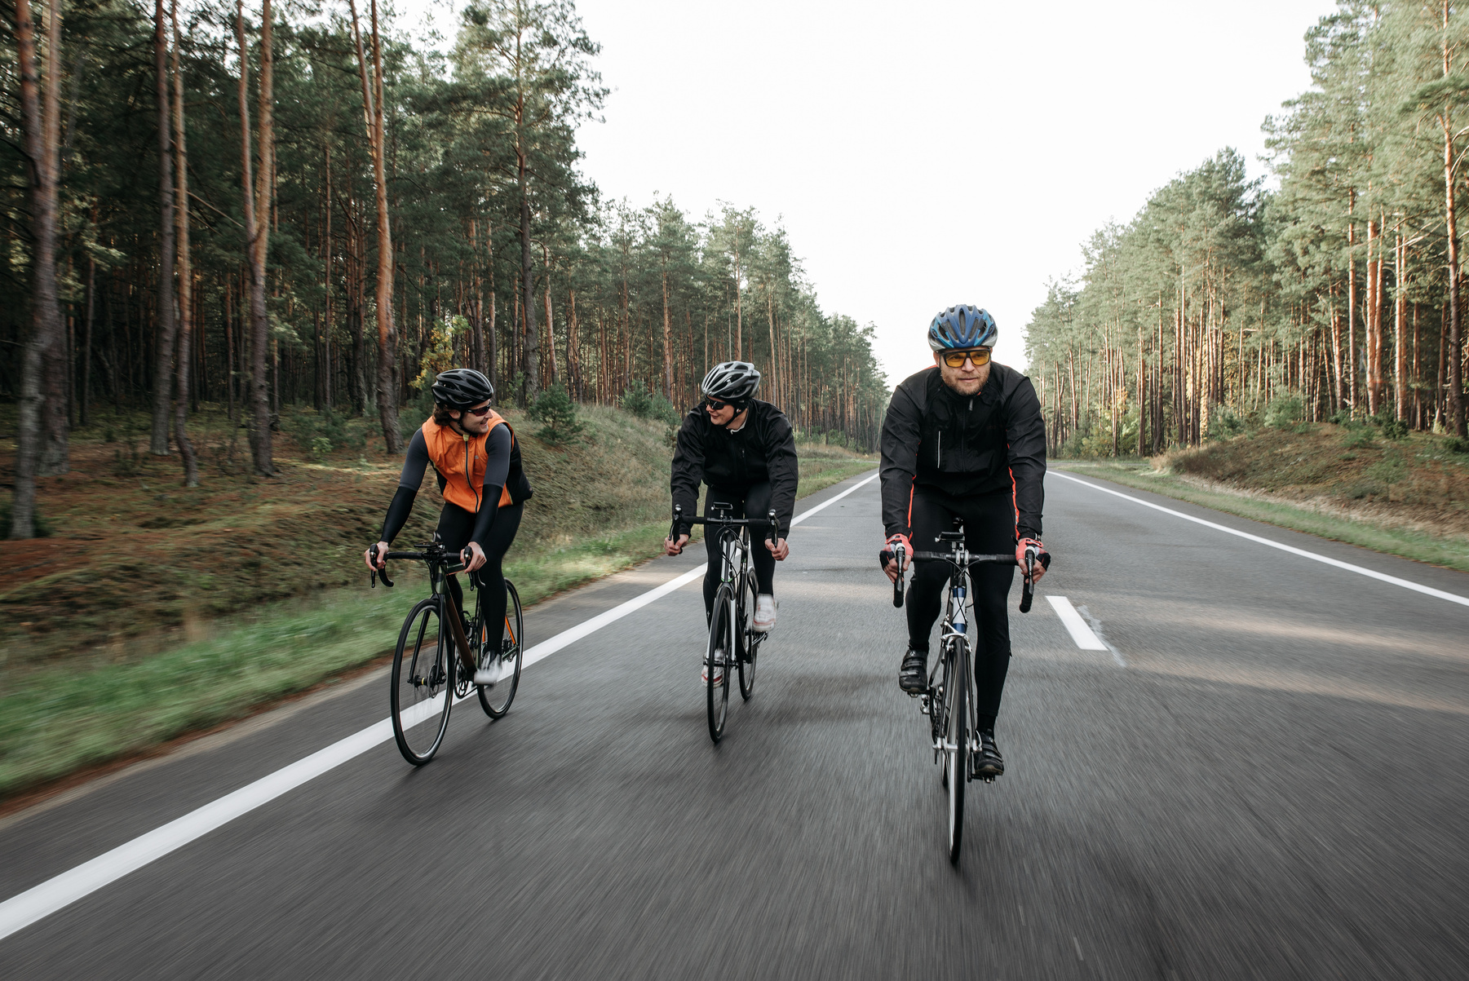
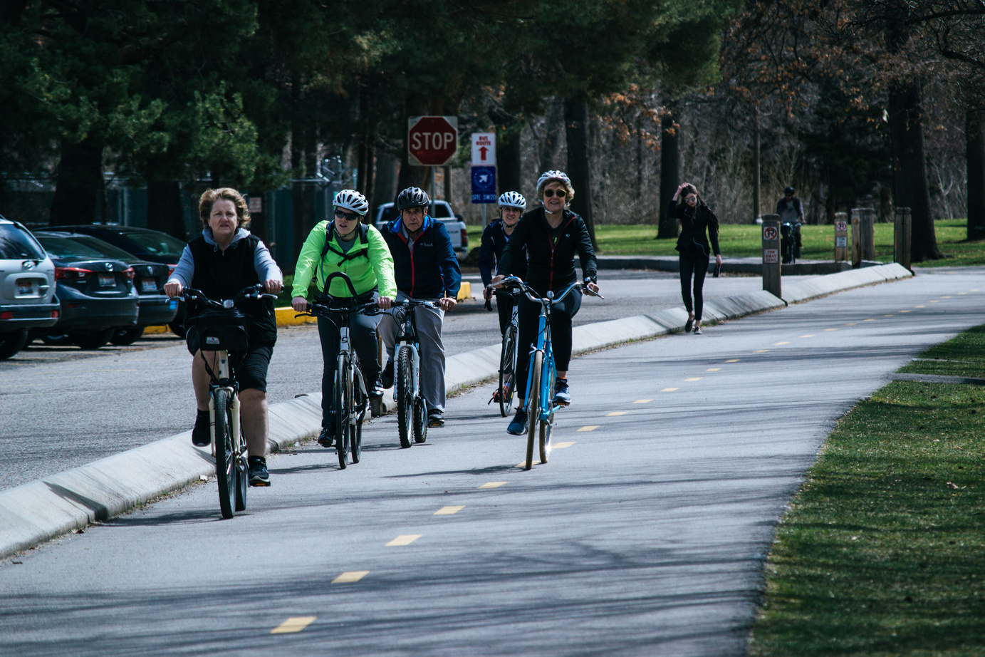
About Cyclistic
5,824 bikes, 692 docking stations in Chicago
Bike type = Classic, Electric
3 pricing models: Casual(single ride, day pass), annual membership
Annual members = more profitable than casual riders

Slide 4

Data Sources
6 months of Cyclistic trip data from feb 2025 to july 2025 (public, Divvy)
Was conducted on a 1st party basis indicating high integrity
Metrics:
ride_id
rideable_type
started_at
ended_at
start_station_name
start_station_id
end_station_name
end_station_id
start_lat
start_lng
end_lat
end_lng
member_casual

Slide 5
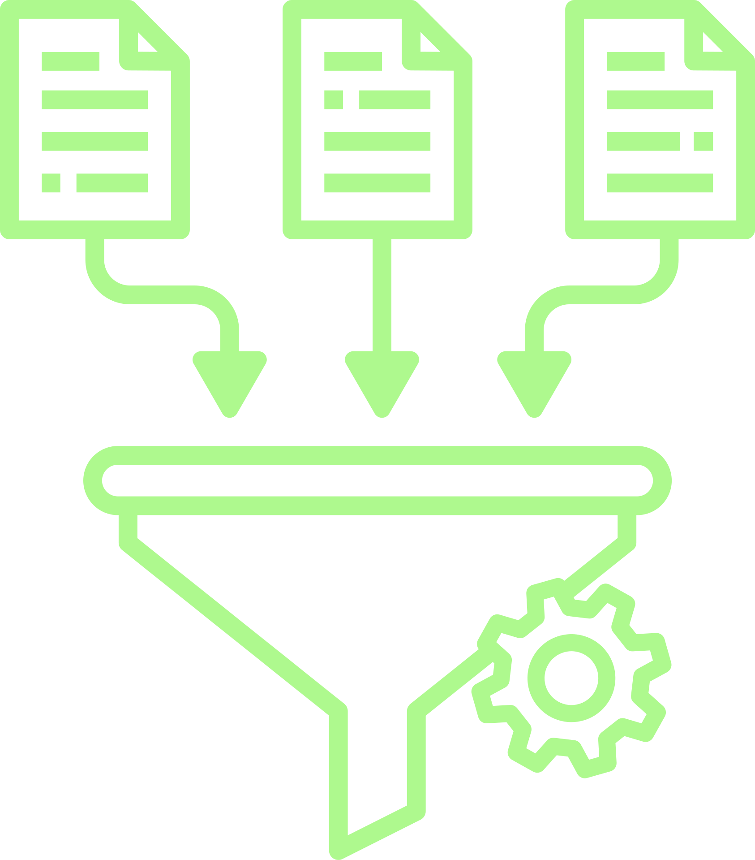
Data Processing
Changed data types and aggregated data month wise in Power Bi platform
Removed unnecessary columns (latitude, longitude, station name and id)
Cleaned missing & inconsistent entries
Created new fields (total journey time, day of week, starting hour)
Aggregated by user type, bike type, and time of day

Slide 6
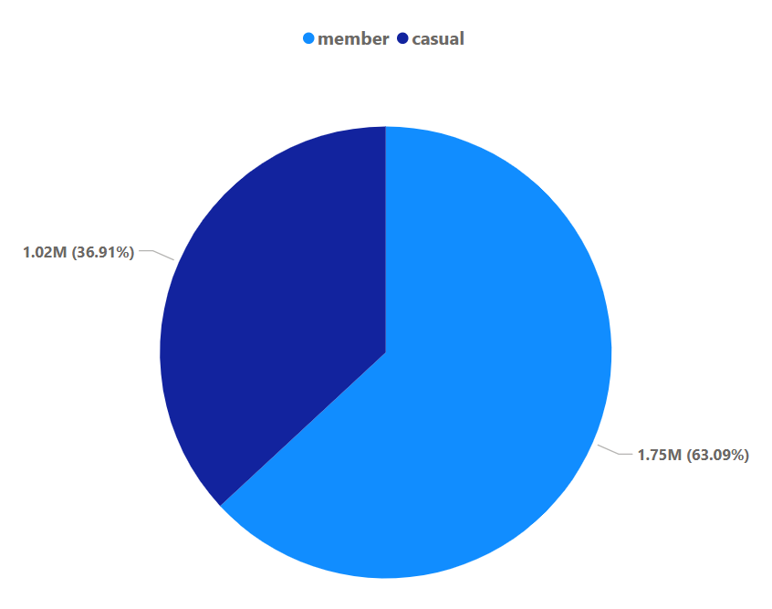
Key Findings
Rider Type Split:
Classic (35.81%)
Casual (36.9%)
Electric (64.19%)
Classic (36.79%)
Members (63.1%)
Electric (63.21%)

Slide 7
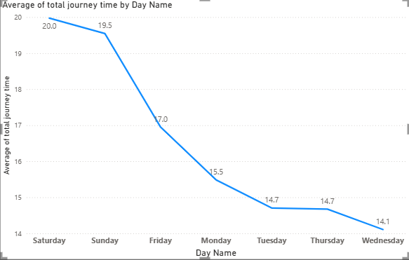
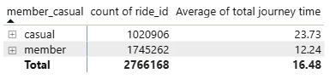
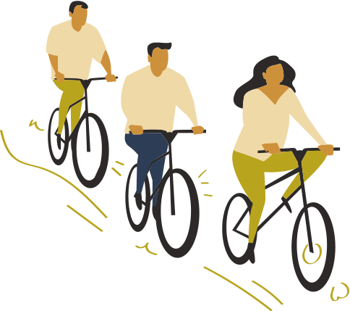
Avg Ride Time:
Casual riders are more likely to use the ride, nearly doubled the time of member riders
Riders are spending more time riding on Saturday and Sunday

Slide 8
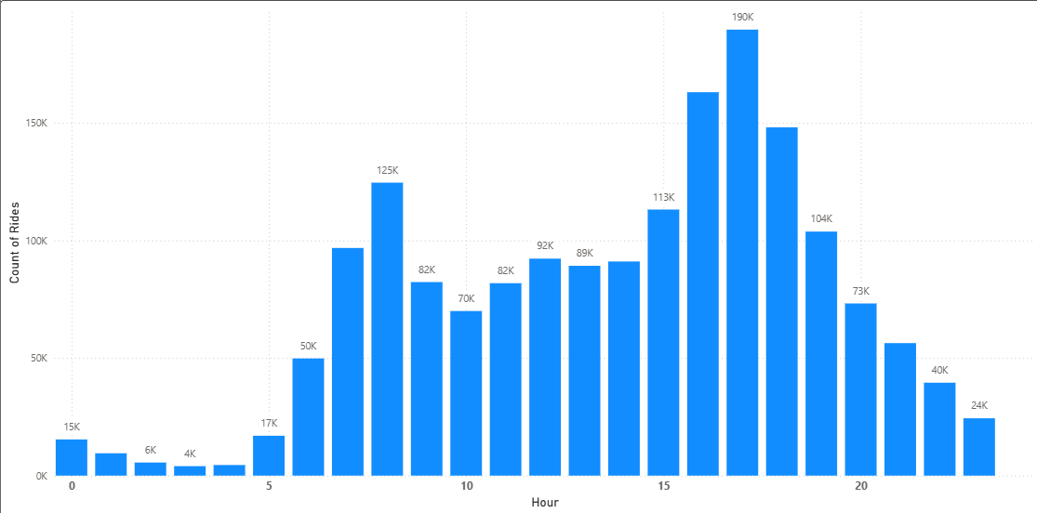
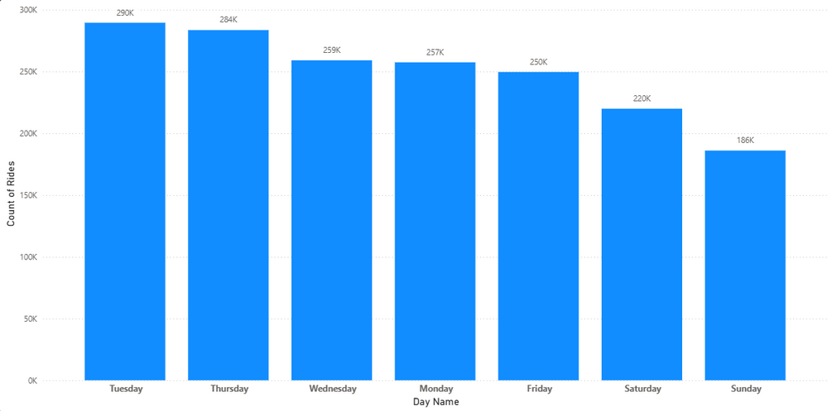
Usage Patterns for MEMBERSHIP RIDERS:
Members are doing mostly rides on Weekdays, from Monday to Friday
Mostly Ride time is from 7–9 AM & 4-6 PM (commuting focus, like going for work or study)
Rides by week :
Rides by hour :

Slide 9
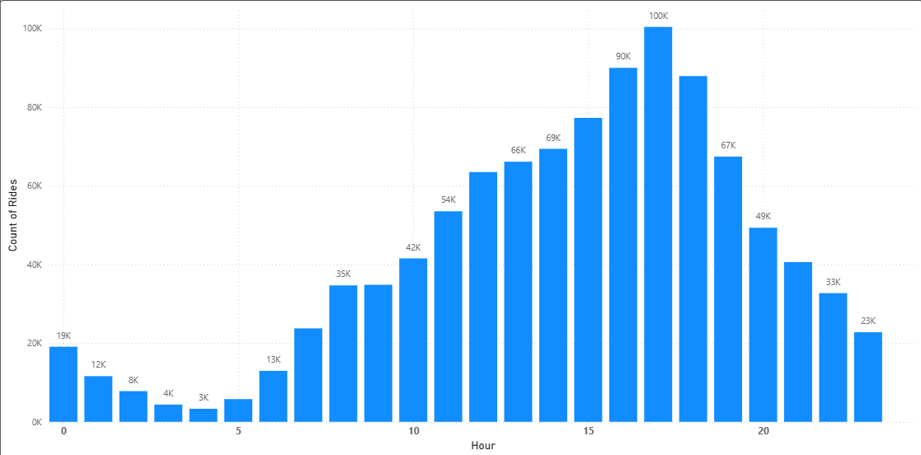
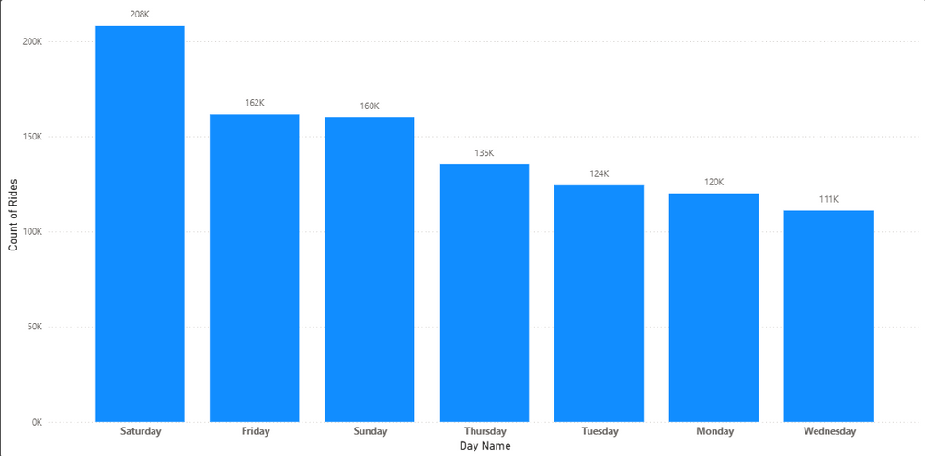
Usage Patterns for CASUAL RIDERS:
Casual riders are doing mostly rides on Weekends, from Friday to Sunday
Mostly Ride time is from 4-6 PM (leisure focus)
Rides by week :
Rides by hour :

Slide 10
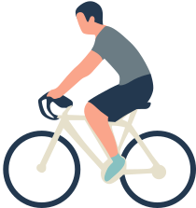
Cyclistic Current Pricing Plans
Single Ride (casual):
Classic Bike → $1 unlock + $0.19/min
Electric Bike → $1 unlock + $0.44/min
Day Pass (casual):
$18.10/day (unlimited 3-hour rides, then $0.19/min after)
Annual Membership:
$143.90/year (≈ $11.99/month)
Includes 45 minutes free per ride
Extra time → $0.19/min (Classic), $0.23/min (Electric after 45 mins)

Slide 11
Break-Even Analysis for Casual Riders :
Average ride time:
Classic Bike → 41 minutes
Electric Bike → 14.56 minutes
Average charge for Casual Rides :
Single Ride :
Day Pass :
Classic : $1 Unlock + (41 mins × $0.19) ≈ $8.79/ride
Electric : $1 Unlock + (14.56 mins × $0.44) ≈ $7.41/ride
Day Pass: $18.10/day

Slide 12

Why Membership is Cheaper :
Membership : $11.99/month → rides under 45 min = $0 extra
Classic : 2 rides/month which is $17.58 → membership cheaper by $5.59 + daily benefits
Electric : 2 rides/month which is $14.82 → membership cheaper by $2.83 + daily benefits
Day Pass which is $18.10 → almost 2 months of membership

Slide 13

Recommendations :
Suggestion to casual to get membership :
Many casuals mostly ride weekends, so create a low-cost monthly new “weekend-only” membership to hook them in, then upsell to full. EX. Weekends they can ride 0.10$ after 45 mins ($75/year)
Show membership ads in-app during 5–7 PM (when casuals ride most). Highlight cost savings if they ride often.
Since members ride weekdays (commuting hours), show casuals how they can save money/time by using bikes for work commutes too.
After a having a single ride or day pass, Give casual riders points from every ride. Thus, they can upgrade to monthly membership with credit earned.
Casual riders pay $1 unlock + per minute. Offer free unlocks for members (especially for e-bikes/classic) to highlight savings.
Send casual riders a monthly summary. EX. “You spent $XX this month as a casual rider. With membership, you would have spent only $11.99.”
Offer discounts or perks (coffee shops, gyms, events) only to members, makes membership more attractive beyond biking.

Slide 14
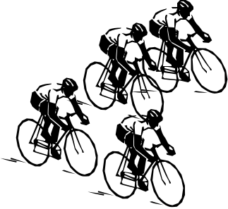
Next Steps :
Run A/B testing on membership offers
Track conversion rates from casual → member
Refine digital campaigns (social media, email, in-app prompts)

Slide 15
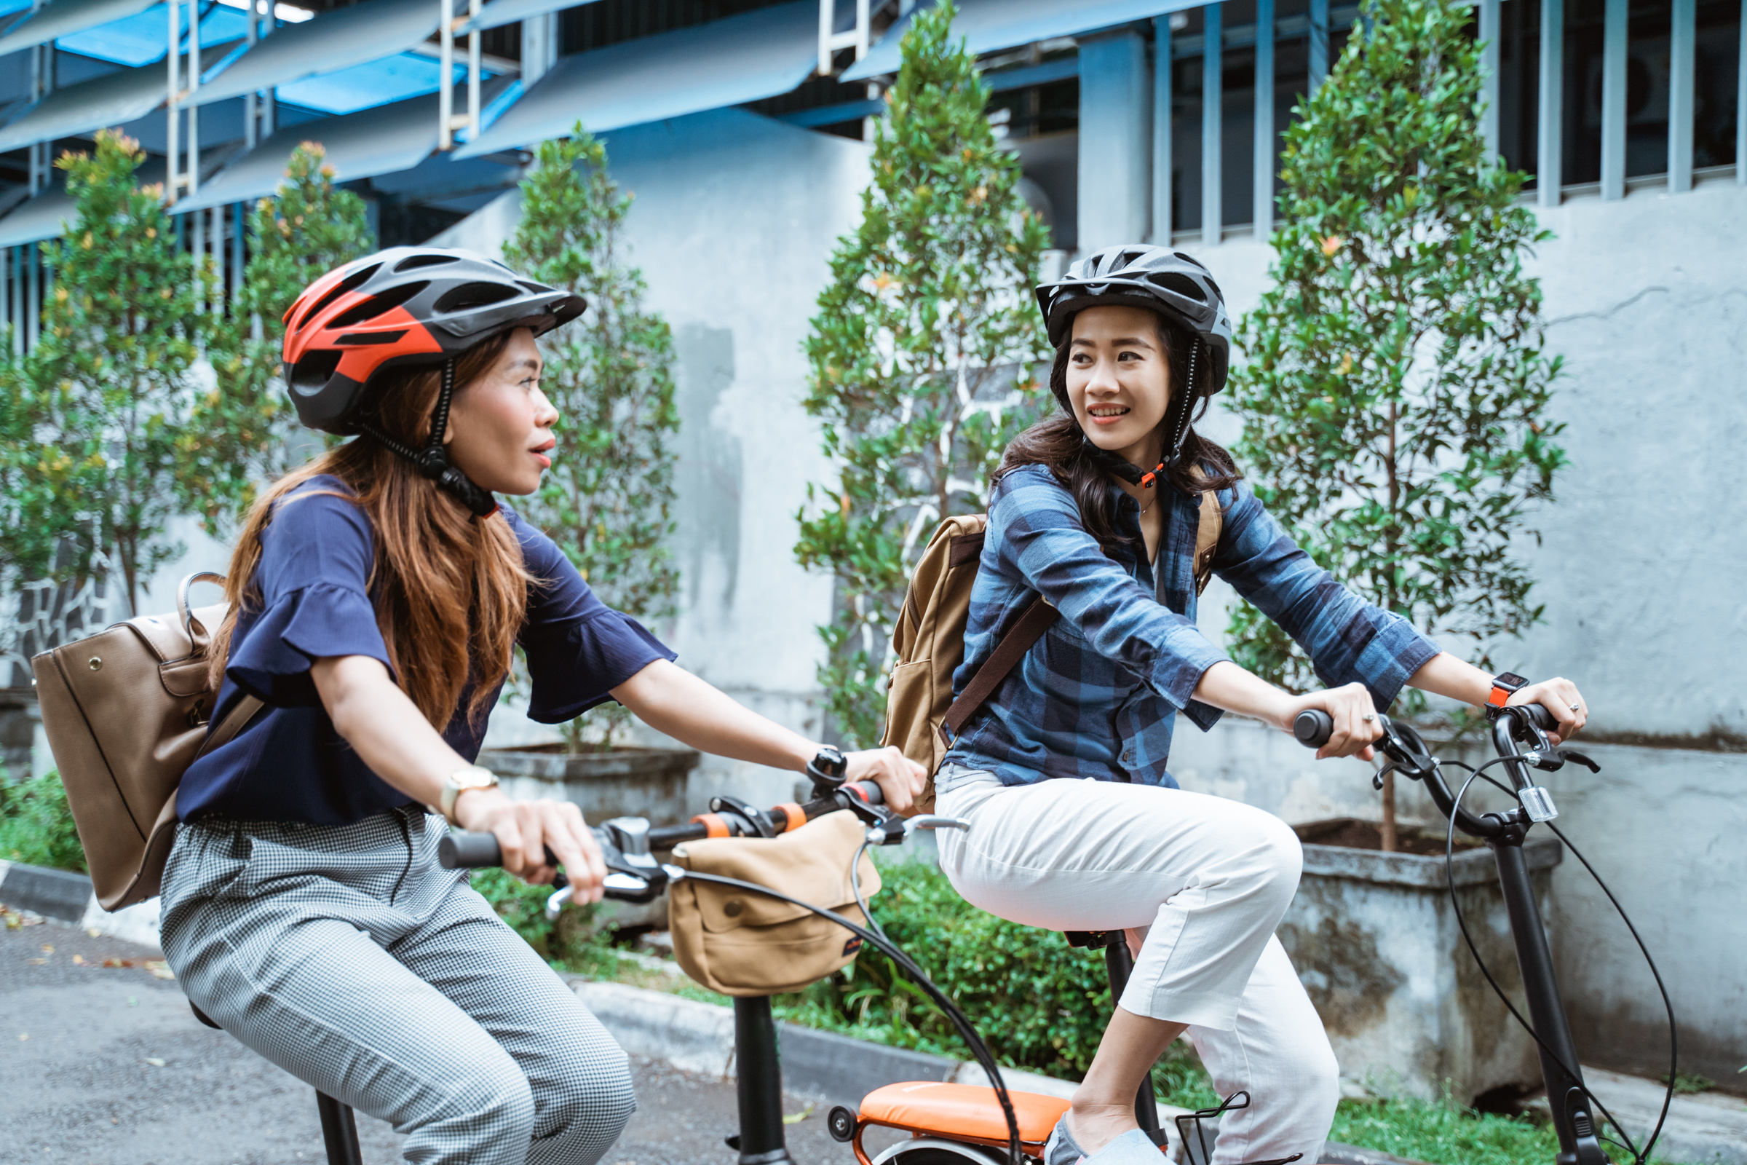




Cyclistic
Thank You
Converting casuals into members is key to Cyclistic’s growth
+44 7799634058
London
nijhingrajiya40@gmail.com
https://www.novypro.com/profile_about/nij-hingrajiya

